Slide 1
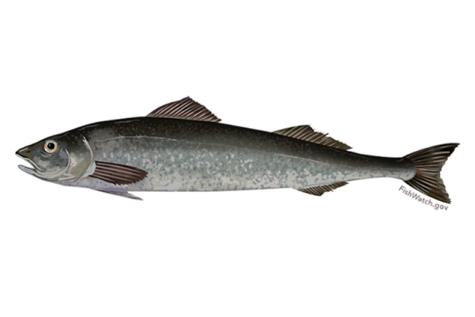

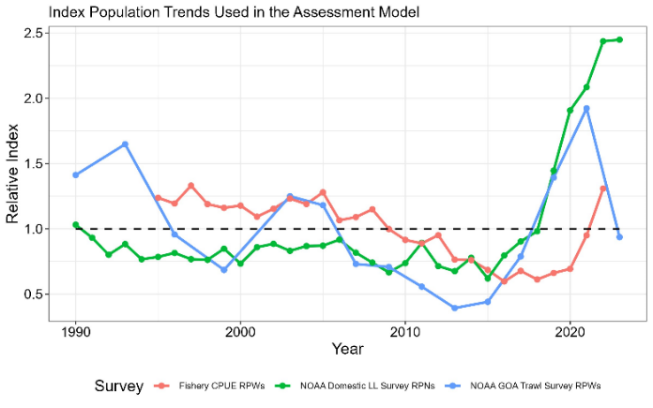
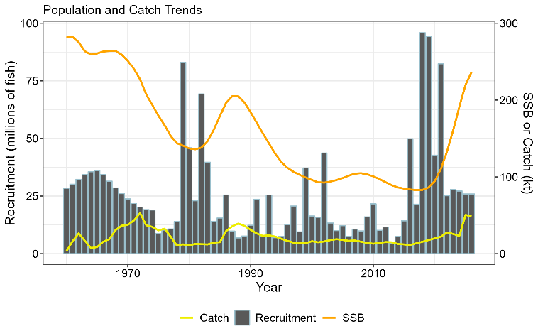
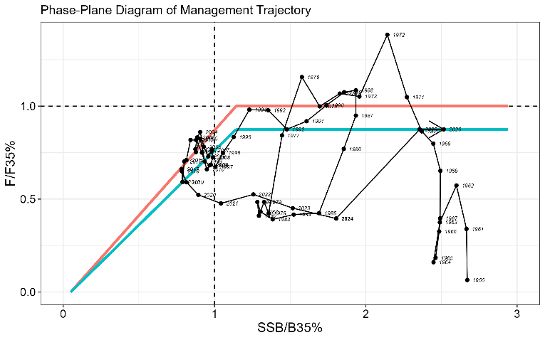
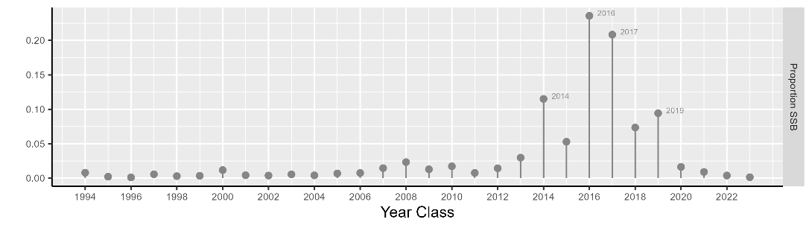
2024 Alaskan Sablefish SAFE (Anoplopoma fimbria)
Data and Stock Assessment Model
Survey indices had been steadily increasing since 2015, but the 2023 NOAA longline survey abundance was stable and the 2023 NOAA Gulf of Alaska trawl survey declined. There were no surveys in 2024.
For 2024 an update assessment was undertaken and there were no changes to the author proposed model (23.5) aside from updated data for 2024 (i.e., catch, fishery lengths, and fishery and survey ages).
The biomass and SSB continue to increase, while recruitment appears to have returned to more average conditions in recent years.
Stock Status and ABC Recommendations
Quantity | 2023 SAFE (Projections for 2024) | 2024 SAFE (Projections for 2025)
B_{100%} | 299,901 | 302,672
B_{40%} | 119,960 | 121,069
SSB_{(Terminal_Yr+1)} | 185,079 | 219,714
SSB_{(Terminal_Yr+1)}/B_{100%} | 62% | 73%
F_{ABC(Terminal_Yr+1)} | 0.086 | 0.087
ABC_{w(Terminal_Yr+1)} | 47,146 | 50,111
OFL_{w(Terminal_Yr+1)} | 55,084 | 58,532
*SSB projections are based on specified catch for the terminal year. ABC_{w} and OFL_{w} are the recommended values after whale depredation has been taken into account.
The resource is not overfished and overfishing is not occurring.
Recent ABCs have not been fully utilized with catch averaging ~71% of the ABC over the last 3 years, but expected to be <50% utilized in 2024 (based on extrapolated landings through the end of the year).
The ABC increased by 6% due to continued maturation and growth (in weight) of the population.
Other Considerations
The population age-structure is beginning to expand with the rapid maturation of the 2014 and 2016 year classes.
2014 – 2021 year classes comprise > 81% of projected 2025 SSB.

